Slide 1
Exploring Milan boroughs
a simple project of data science.

Slide 2
Contents
Introduction
Data acquisition
Data cleaning
Data Analysis
Modeling
Results
Discussion
Conclusion
4/28/2020

Slide 3
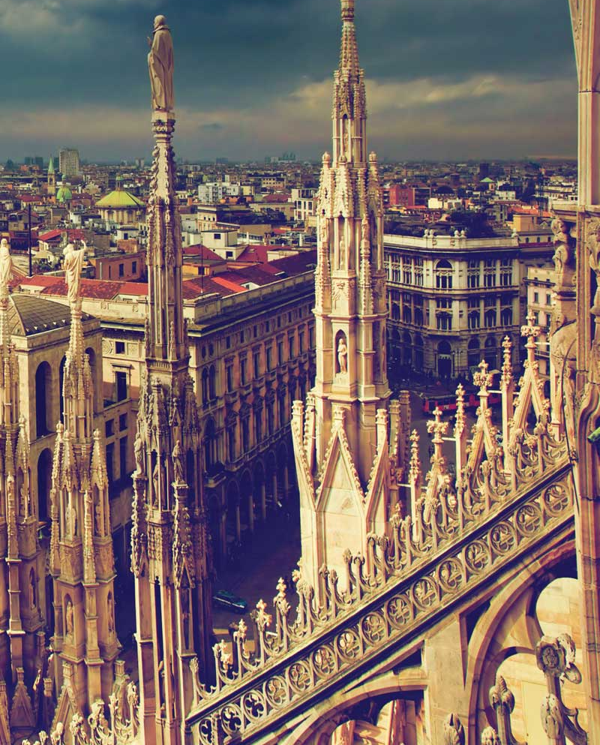
Introduction
I will explore the nine main boroughs of Milan, in Italy
Milan has been steadily growing in recent years
Number of tourists is increasing
There are many venues and in particular restaurants
Where would it be optimal to open a new business?

Slide 4
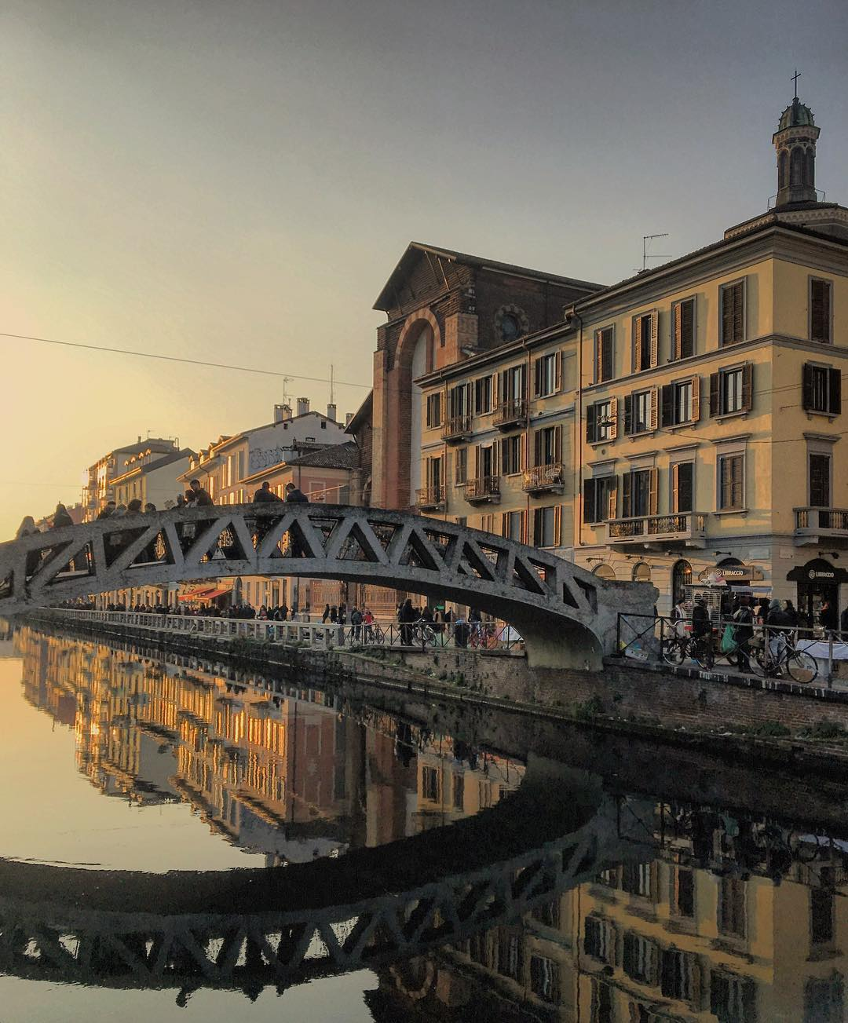
Data Acquisition
Municipalities of Milan from Wiki.
Pgeocode from geopy to retrieve coordinates.
Foursquare API to explore the boroughs.

Slide 5
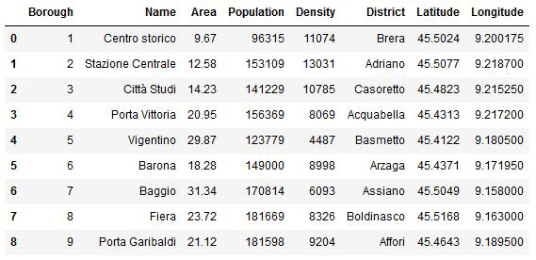
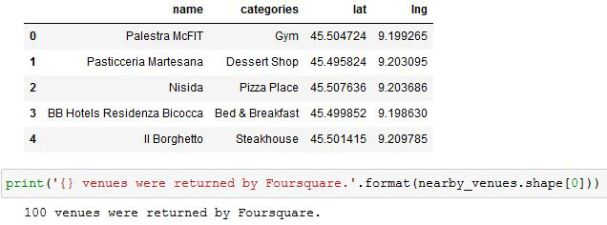
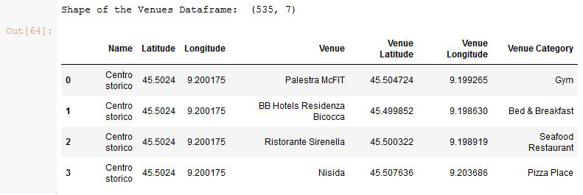
Data Cleaning
Data frame from Wiki and geopy
Data from foursquare
Final data frame, merged
Data were scraped from a Wikipedia table using BeautifulSoup and coordinates were retrieved with geopy
The Foursquare API made possible to retrieve all the venues for any borough
This is an example for the first borough
All data were combined in the merged data frame

Slide 6
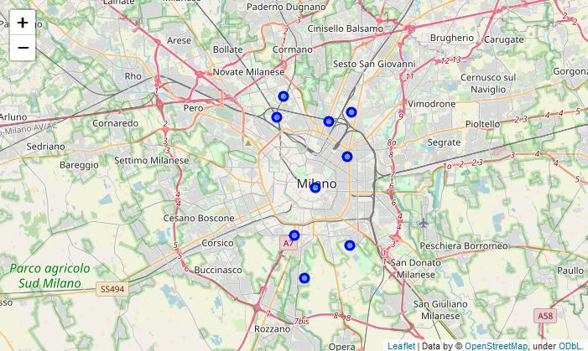
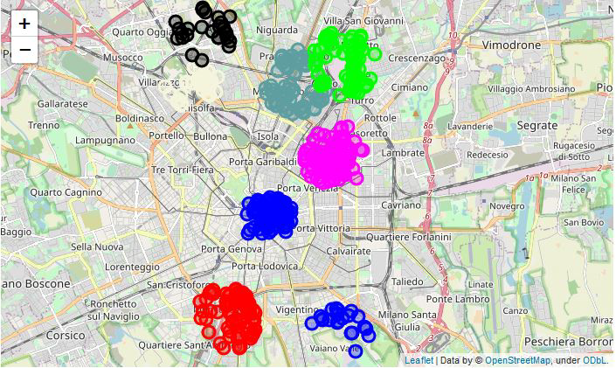
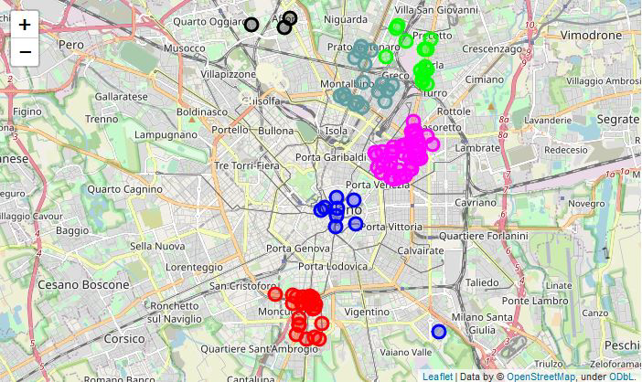
Data analysis
Boroughs
Venues
Restaurants
The boroughs were highlighted on the map
Every venue for every borough were displayed
Only restaurants between venues were highlighted

Slide 7
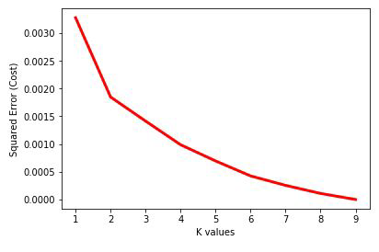
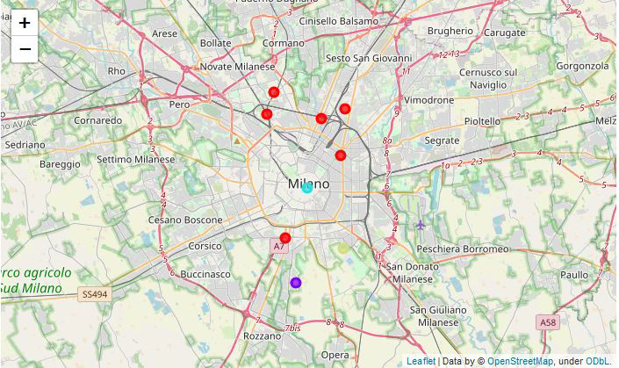
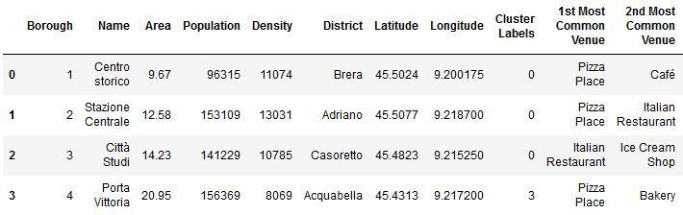
modeling
Choice of K
Clustering of boroughs
Map of clusters
A value K = 4 was selected to perform the K-Means clustering on the data frame
All venues and boroughs were clustered and a Cluster Lable was assigned for every row
The clusters were grouped on the map

Slide 8
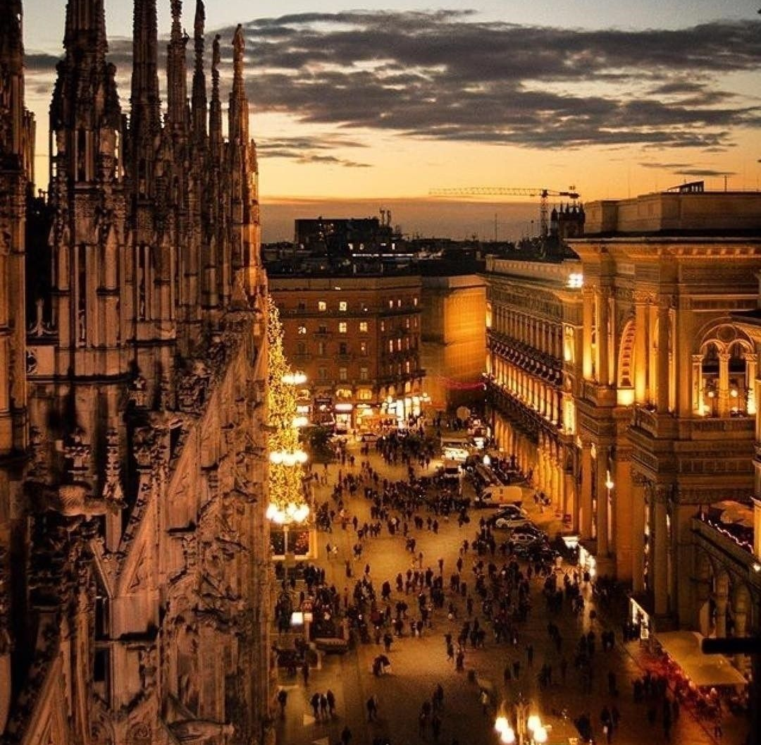
results
Cluster 0 includes six boroughs and most venues are restaurants
Cluster 1 is borough “Vigentino” and it is where people play sports
Cluster 2 is borough “Porta Garibaldi” and it’s famous for spending free time and for tourist facilities
Cluster 3 is borough “Porta Vittoria” and it is a place for eating pizza and baked goods
Fabio Marco Monetti
4/28/2020

Slide 9
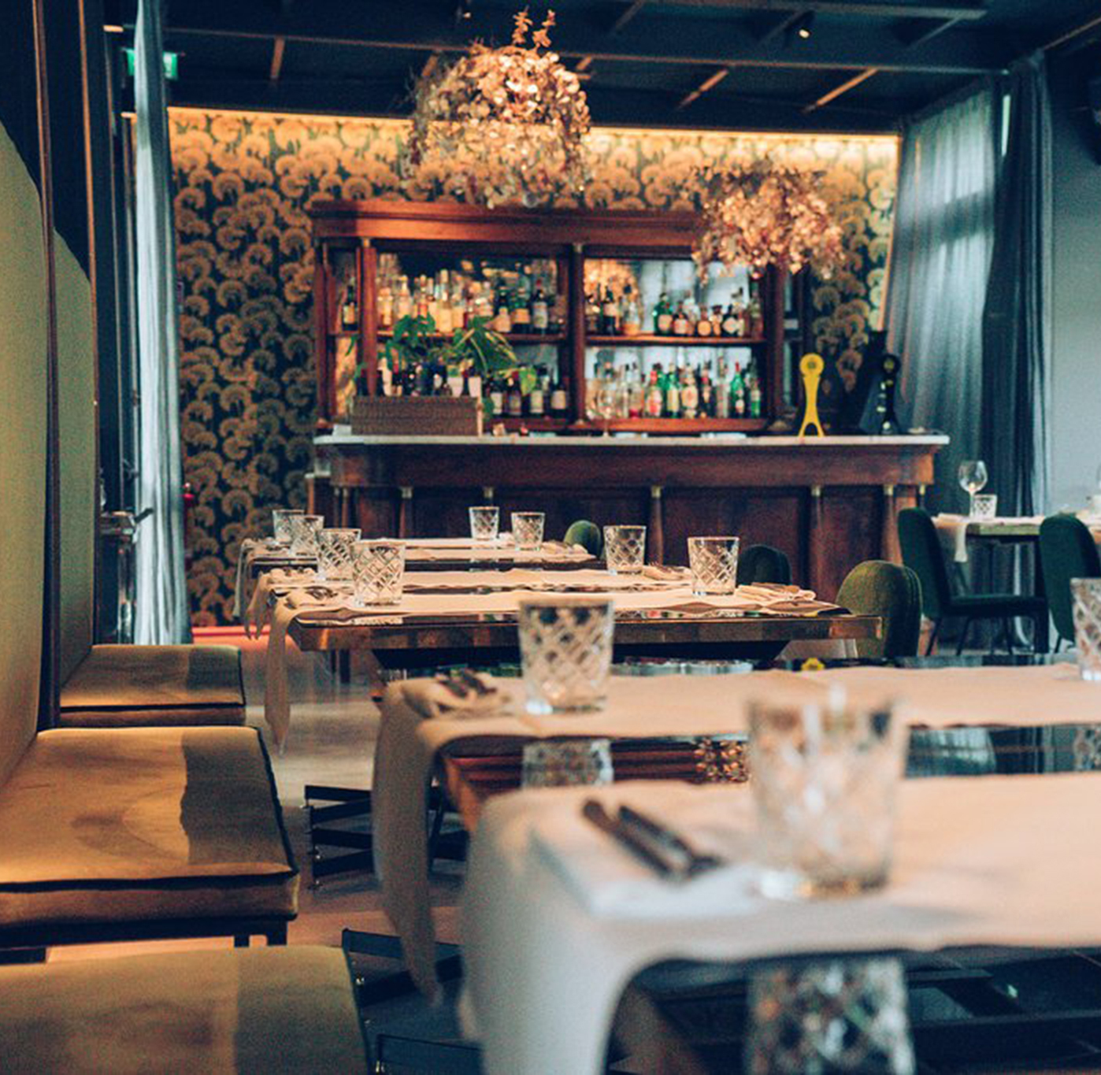
discussion
In Cluster 0 there is much competition
In Cluster 1 people go for sports, not for restaurants
Cluster 2 is perfect for a new restaurant because there are tourists and people go in their spare time
Cluster 3 is famous for its “pizzerie” e “paninari”
Fabio Marco Monetti
4/28/2020

Slide 10
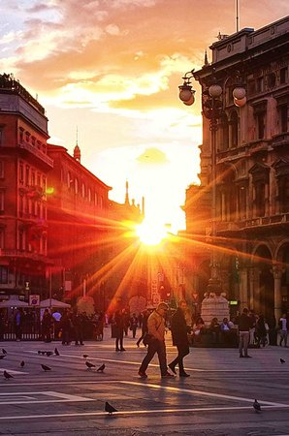
conclusion
We found the best place to open a restaurant in Milan
High reproducibility for other kinds of venues
Future development
Increment the number of samples (districts)
Increment the number of venues and include other shops

